Slide 1



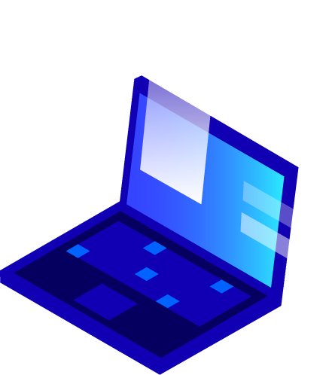


MINI PROJECT PRESENTATION

Slide 2
STONE,PAPER AND SCISSOR(GAME)
Supervised By: -
Priya Agrawal Mam
(Technical Trainer)
Department of Computer Engineering & Applications
GLA UNIVERSITY MATHURA
Submitted By:
Shantanu Saraswat
(181500651)

Slide 3
INTRODUCTION
Stone Paper Scissor (Web-based Game) is perfect for this game Lovers, that allows users to play this game with computer ,the random function which is used here generates one of the three stone or paper or scissor and it is then compared with our choice and the result is printed as won,lose or tied.
For this Application we will be using both Frontend and Backend Technologies and Database for storing the data.
Our major objective will be to make this web based Game as much user friendly as we can and providing them a good way to spend their free time.

Slide 4
OBJECTIVE
Rock paper scissors is often used as a fair choosing method between two people, similar to coin flipping, drawing straws, or throwing dice in order to settle a dispute or make an unbiased group decision. Unlike truly random selection methods, however, rock paper scissors can be played with a degree of skill by recognizing and exploiting non-random behavior in opponents.
Our goal is to deliver a webGame with a very clean user interface (website) where customers can select their choice according to their will.

Slide 5
ABOUT WEB DEVELOPMENT
Web development is a broad term for the work involved in developing a web game for the Internet (World Wide Web). Web development commonly includes web engineering, web design, web content development, client-side/server-side scripting, web server and network security configuration, and e-commerce development. Among web professionals, “web development” usually refers to the main non-design aspects of building web sites: writing markup and coding. Websites are typically dedicated to a particular topic or purpose, ranging from entertainment and social networking to providing news and education.

Slide 6

Technologies Used:
HTML5
HTML is the standard markup language for documents designed to be displayed in a web browser.
HTML describes the structure of a web page semantically and originally included cues for the appearance of the document.
HTML provides a means to create structured documents by denoting structural semantics for text such as headings, paragraphs, lists, links, quotes and other items.

Slide 7
Technologies Used:
CSS3
CSS is designed to enable the separation of presentation and content, including layout, colors, margins and also fonts.
This separation can improve content accessibility, provide more flexibility and control in the specification of presentation characteristics.
CSS enables multiple web pages to share formatting by specifying the relevant CSS in a separate .css file which reduces complexity and repetition in the structural content.

Slide 8
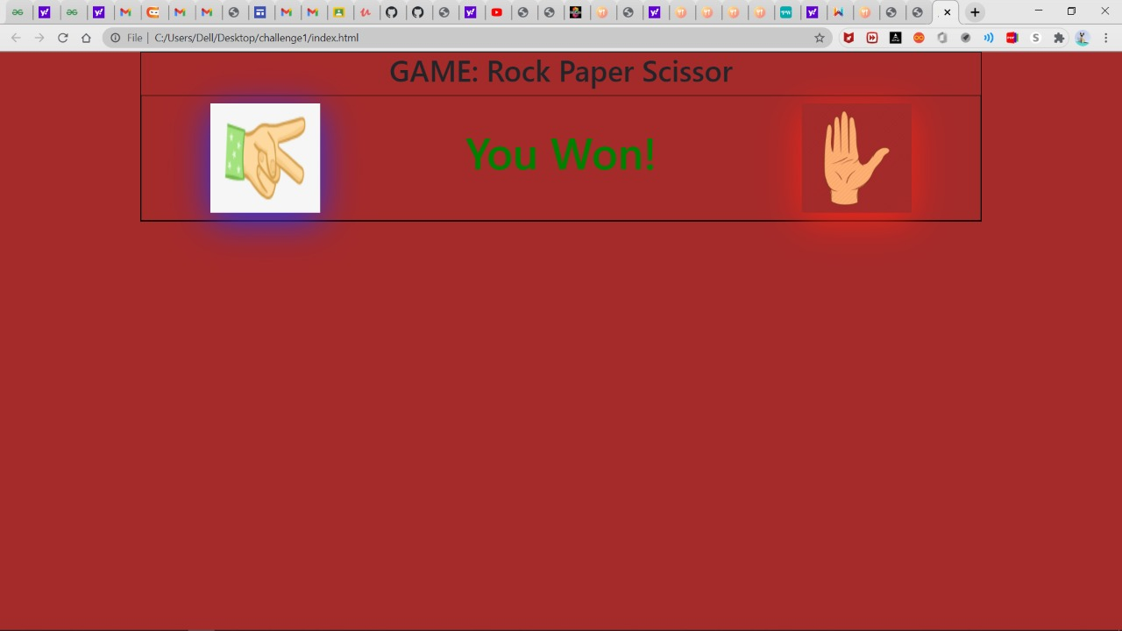
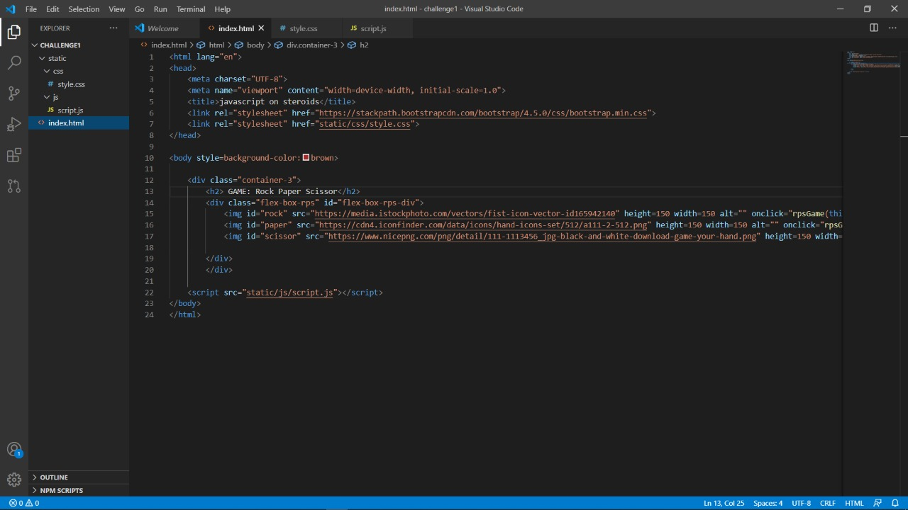

Slide 9
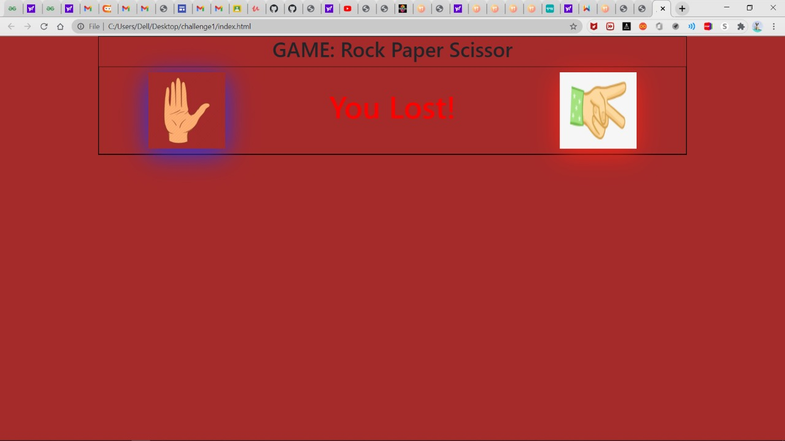
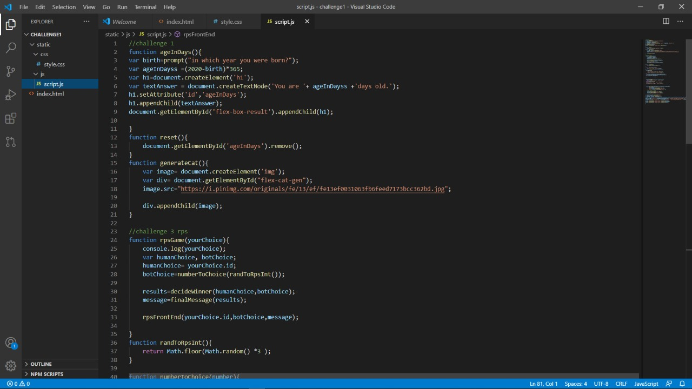

Slide 10
Technologies Used:
JavaScript
JavaScript enables interactive web pages and is an essential part of web applications.
The vast majority of websites use it for client-side page behavior, and all major web browsers have a dedicated JavaScript engine to execute it.
As a multi-paradigm language, JavaScript supports event-driven, functional, and imperative programming styles.

Slide 11
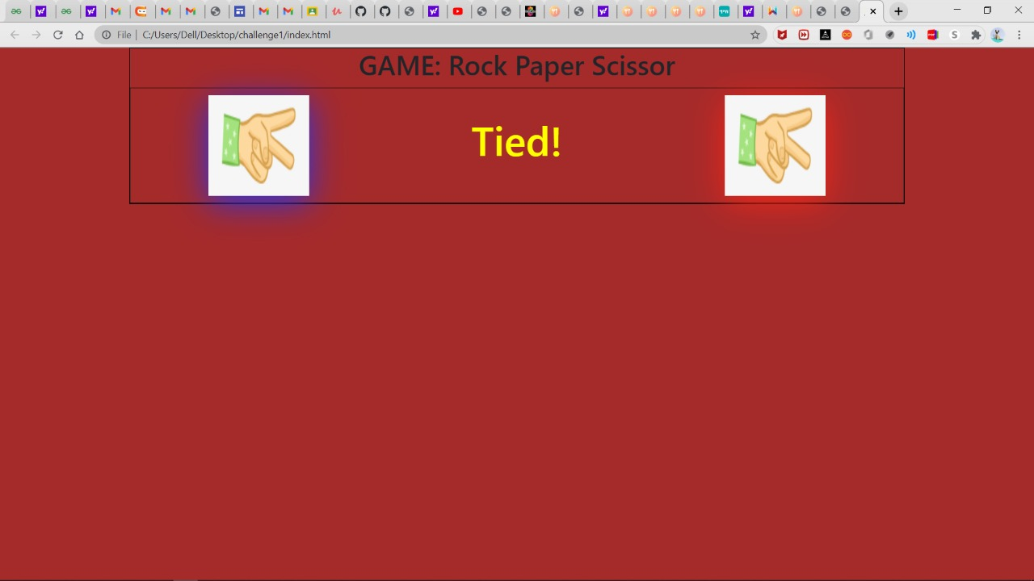
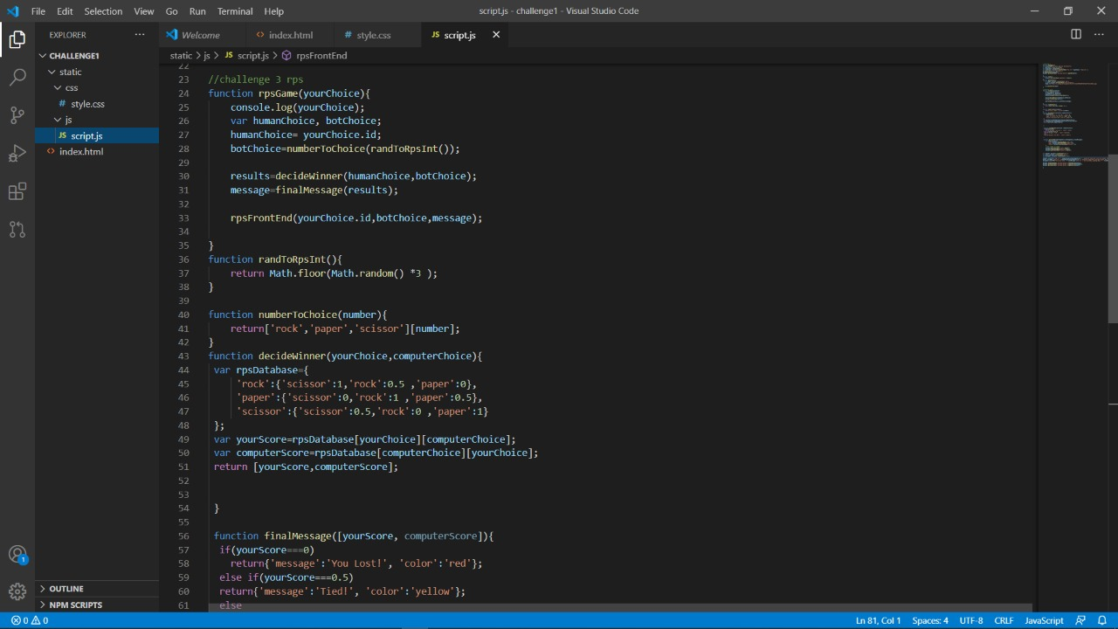

Slide 12
Technologies Used:
Bootstrap
Bootstrap 4 is the newest version of Bootstrap.
Bootstrap is a free and open-source CSS framework directed at
responsive, mobile-first front-end web.
In addition, developers can take advantage of CSS classes defined in Bootstrap to further customize the appearance of their contents.
Bootstrap also comes with several JavaScript components in the form of jQuery plugins.

Slide 13
Technologies Used:
jQuery
jQuery is a fast, small, and feature-rich JavaScript library. It makes things like HTML document traversal and manipulation, event handling, animation, and Ajax much simpler with an easy-to-use API that works across a multitude of browsers.
The set of jQuery core features—DOM element selections, traversal and manipulation—enabled by its selector engine, created a new "programming style", fusing algorithms and DOM data structures

Slide 14
Technologies Used:
php
PHP is a server scripting language, and a powerful tool for making dynamic and interactive Web pages.
PHP is a widely-used, free, and efficient alternative to competitors such as Microsoft's ASP.
PHP 7 is the latest stable release.
The best things in using PHP are that it is extremely simple for a newcomer, but offers many advanced features for a professional programmer.

Slide 15
CONCLUSION
With the help of latest web technologies we have created a online GAME web application ,named STONE, PAPER AND SCISSOR , which has a descent graphical user interface the use of css and bootstrap also makes the visualization beautiful and appealing ,this has been an excellent and rewarding learning experience. Needless to say, the technical aspects of the work we have done are not flawless and could be improved provided enough time.
As someone with no prior experience in web development, we believe our time spent in training and discovering new languages was well worth it and contributed to finding an acceptable solution to an important aspect of web design and development.

